Slide 1

B.M.S COLLEGE OF ENGINEERING
Bull Temple Road, Basavanagudi, Bangalore - 560 019, Karnataka, India
Department of Electronics and Communication Engineering
2020 – 21
MINI PROJECT TOPIC
HOME AUTOMATION USING DTMF
Submitted by
SUKSHITH B JAIN– 1BM18EC156
SUMUKHA K S – 1BM18EC158
SURAJ S – 1BM18EC160
VAISHAKH M S – 1BM18EC173
Under the guidance of
Assoc. Prof SHAILA V HEGDE

Slide 2

Introduction
In this world, people require comfort and easy life to live.
Home automation is an emerging trend in modernization of home appliances.
For every work we are dependent on electrical appliances.
We have abundant appliances to help us but we need to have innovation.
The aim of this project is to develop home automation system that can be controlled remotely using mobile phones.

Slide 3
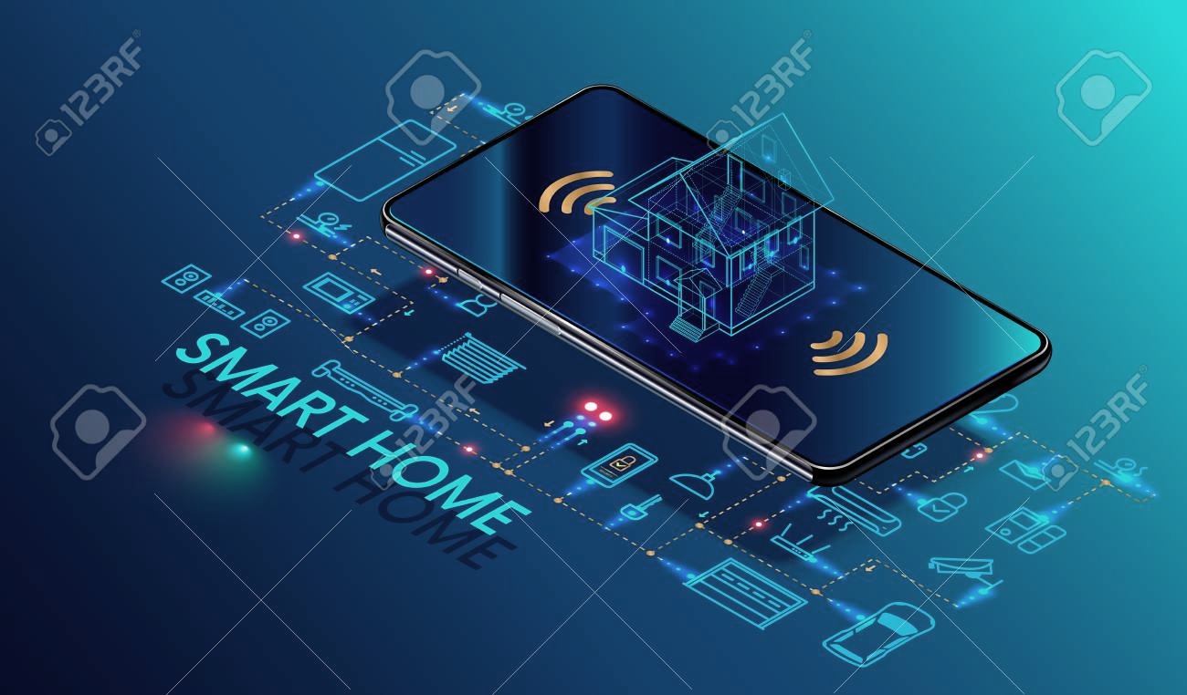
Scope of the project
To build a smart home
For wireless control of the electrical appliances
To make the work easy in our busy life
To preserve energy
To improve the life of appliances

Slide 4

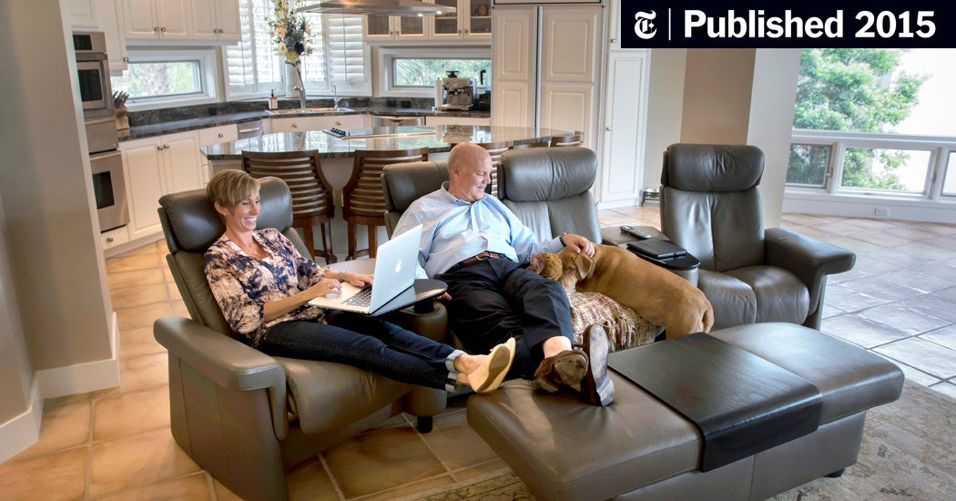
PROBLEM DEFINITION
The problems related to forgetting to switch off the lights or to lock the doors which may lead to energy loss, reduce power efficiency and reduce the life span of the appliance.

Slide 5
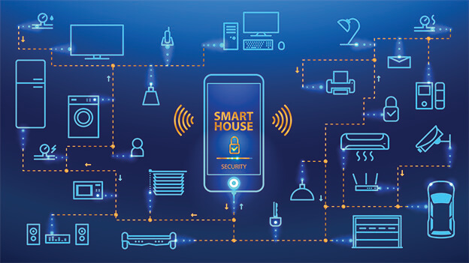
PROPOSED SOLUTION
The wireless remote control system
Smart Home can be built by using
Bluetooth
Wi-Fi
IOT
We are building a system using DTMF

Slide 6
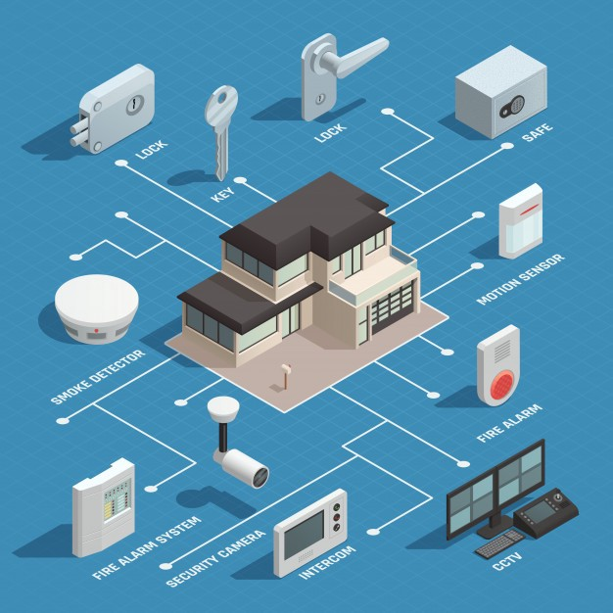
PROJECT OBJECTIVE:
The objective of this project is to implement a low cost, reliable and scalable home automation system that can be used to remotely switch on or off any household appliance
We’ll using a microcontroller to achieve hardware simplicity, low cost short message service (SMS) for feedback and voice dial from any phone to toggle the switch state.

Slide 7
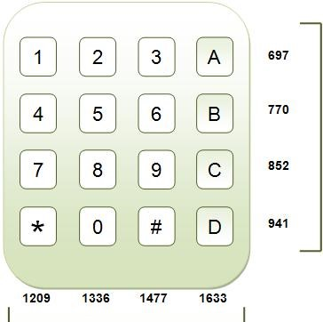
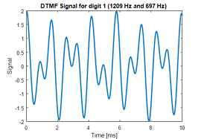
DTMF-Dual Tone Multi Frequency
DTMF is a system for identifying number dialed on a pushbutton or DTMF keypad.
DTMF keypad is a 4×4 matrix of push buttons.
DTMF is sum of two sine waves one from 697 to 940Hz and other from 1209 to 1663 Hz.
Each group contain 4 individual tones which form 16 combinations.
By using band pass filter we can decode in receiver section.

Slide 8
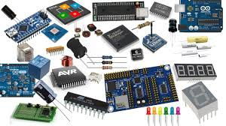
COMPONENTS REQUIRED
MICROCONTROLLER : ARDUINO UNO
DTMF DECODER – MT 8870
RELAY
DTMF KEYPAD
MOBILE-PHONE
SIM-CARD

Slide 9
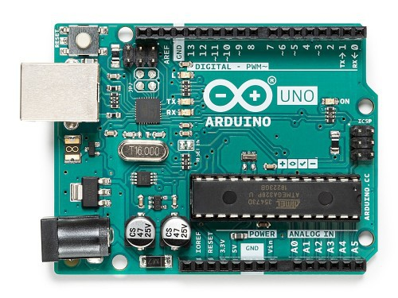
COMPONENTS WORKING
MICROCONTROLLER : ARDUINO UNO
A microcontroller is a compact microcomputer designed to govern the operation of embedded systems
A typical microcontroller includes a processor, memory, and peripherals. The simplest microcontrollers facilitate the operation of the electromechanical systems found in everyday convenience items
Arduino is an open source electronics prototyping platform that is flexible, easy-to-use hardware and software

Slide 10
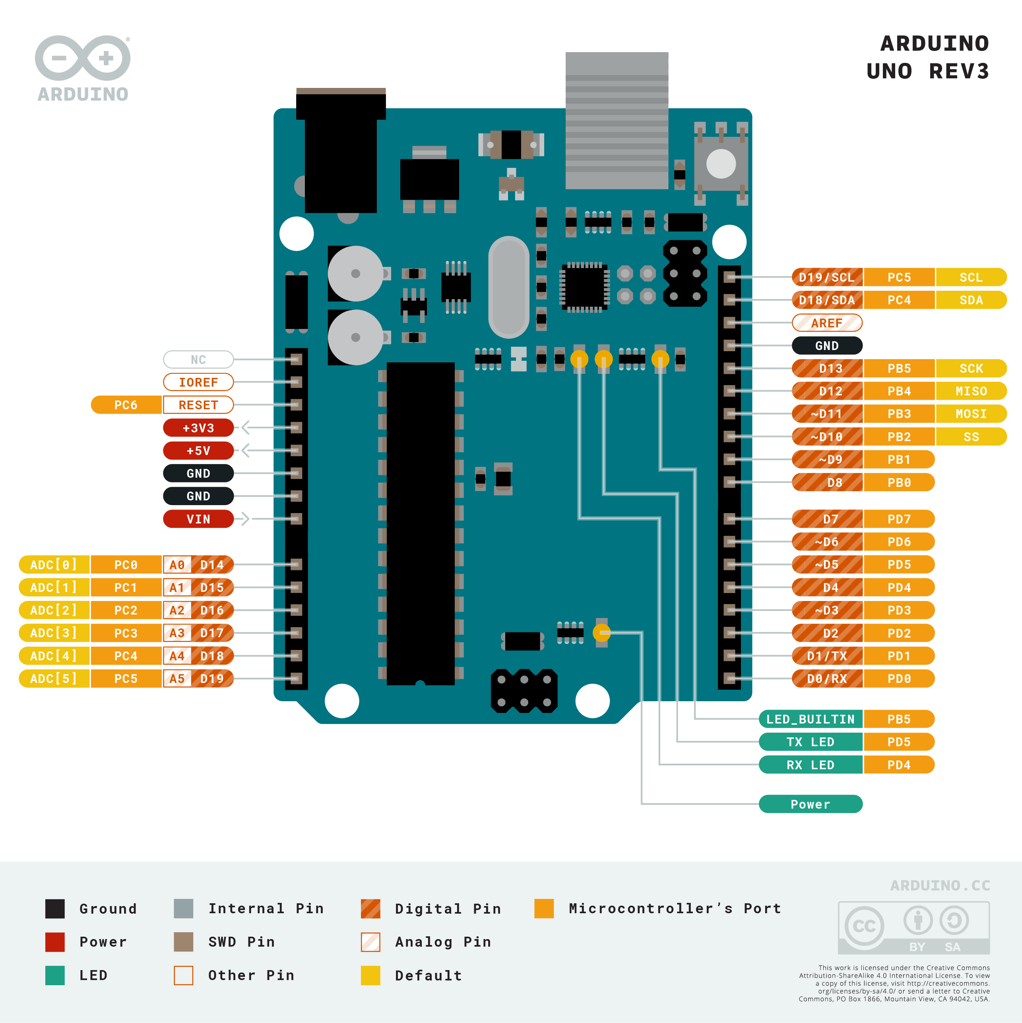
ARDUINO UNO PIN DIAGRAM

Slide 11
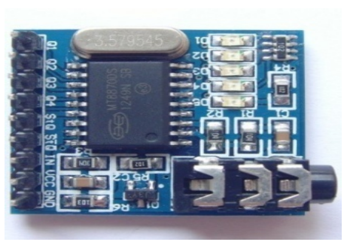
2 . DTMF Decoder
The DTMF Decoder (MT8870) is a device which is used to decode the DTMF tones generated by the dialer keys of a cell-phone. The decoder utilizes the digital counting techniques to detect and decode all 16 DTMF tone-pairs into a 4-bit binary code
Ac register signaling is used in dtmf telephones, here tones rather than make/break pulse are used for dialing, and each dialed digit is uniquely represented by a pair of sine waves tones

Slide 12
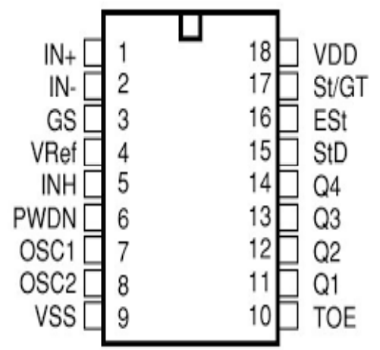
DTMF DEOCDER PIN DIAGRAM
Pin Numbers
- Non inverting input
- Inverting input
- Ground
- Reference Voltage
- Enable for A B C D Input
- Oscillator
7,8 – External Oscillator
- Source Voltage
- Output Enable pin
to 14 - Output
- Stand By
- ESt
- GT/ST
- Drain Voltage

Slide 13
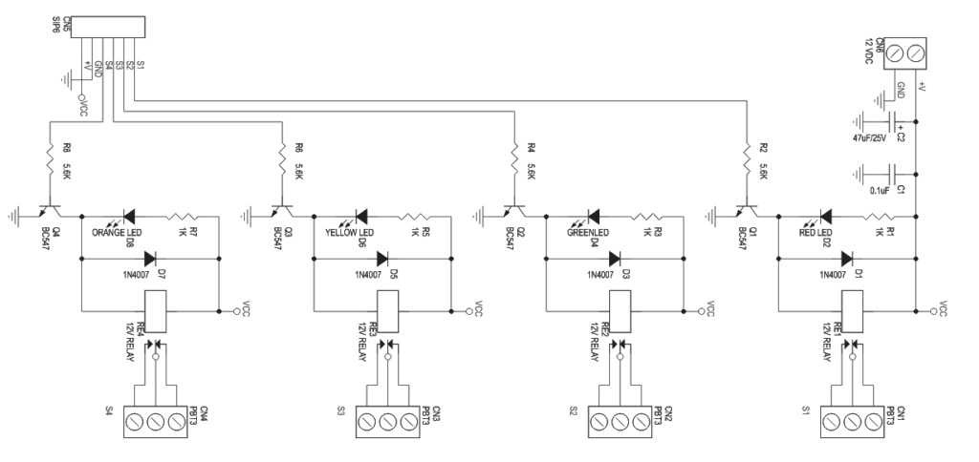
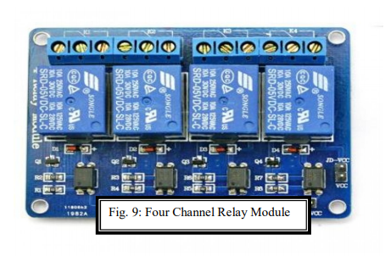
3. Relay module
A relay is a device which allows us to turn on or turn off a circuit with voltage and which is much higher than what Arduino could handle.
Relay provides complete isolation between the low-voltage circuit placed on the Arduino side and the high-voltage side which is connected to the load. For this project we have used a 4 channel, 5V relay.
This 5V 4-channel relay interface board and each channel needs a 15-20mA driver current.

Slide 14
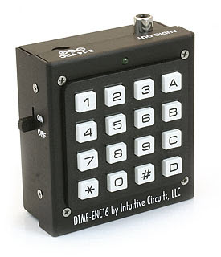
4. DTMF KEYPAD
A DTMF keypad (generator or encoder) generates a sinusoidal tone which is mixture of the row and column frequencies.
The DTMF Keypad is laid out in a 4×4 matrix of push buttons. The row frequencies are low group frequencies. The column frequencies belong to high group frequencies.
This prevents misinterpretation of the harmonics. Also the frequencies for DTMF are so chosen that none have a harmonic relationship with the others and that mixing the frequencies would not produce sum or product frequencies that could mimic another valid tone.

Slide 15
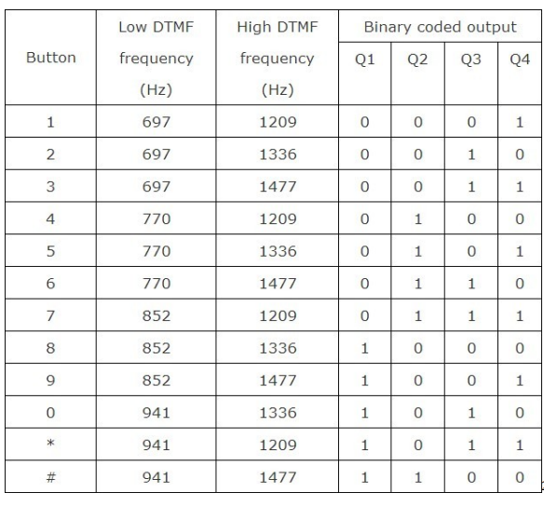
PROJECT ANALYSIS
DTMF decoder
A valid dtmf signal is the sum of two tones, one from a lower group (697-940 Hz) and the other from a higher group (1209-1663 Hz).
Each group contains four individual tones. This scheme allows 10 unique combinations. Ten of these code represent digits 1 through 9 and 0.
Tones in DTMF dialing are so chose that none of the tones is harmonic of are other tone. Therefore, there is no change of distortion caused by harmonics

Slide 16
The dtmf signal contains only one component from each of the high and low group.
This significantly simplifies decoding because the composite dtmf signal may be separated with band pass filters into single frequency components, each of which may be handled individually.

Slide 17
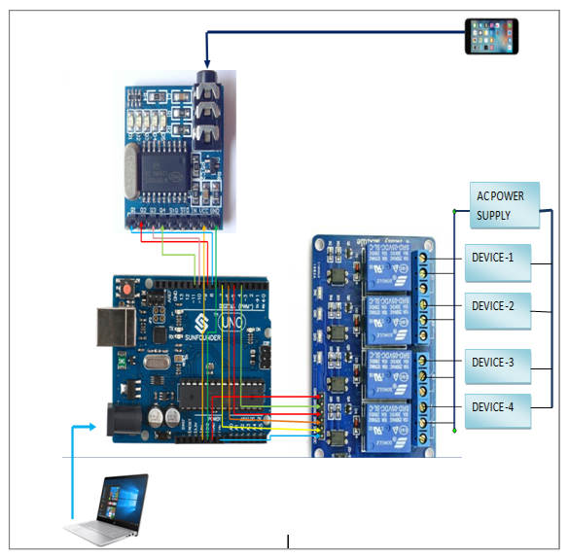
CIRCUIT CONNECTION

Slide 18
WORKING OF CIRCUIT
When the user dials the home mobile number the phone at home rings and if nobody picks the call, then the system picks up the call automatically.
When we press any number on the phone keypad it generates a particular frequency, which is received by the other phone and then the code/number is decoded by the DTMF decoder /receiver.
Here the decoder decodes the frequency of the tone generated by the particular code/number.
The Connection Layout of the Hardware 34 DTMF decoder generates a binary output which is given to the microcontroller.
Here a program code is fed to the microcontroller which activates the relay module according to the key pressed by the user.
At the output of the microcontroller the devices are connected to a 4-channel relay module.
It is a driver which drives the appliances based on the microcontroller output. Thus, when the relay drive is activated by the microcontroller, the device either gets ON or is switched OFF as per the requirement

Slide 19
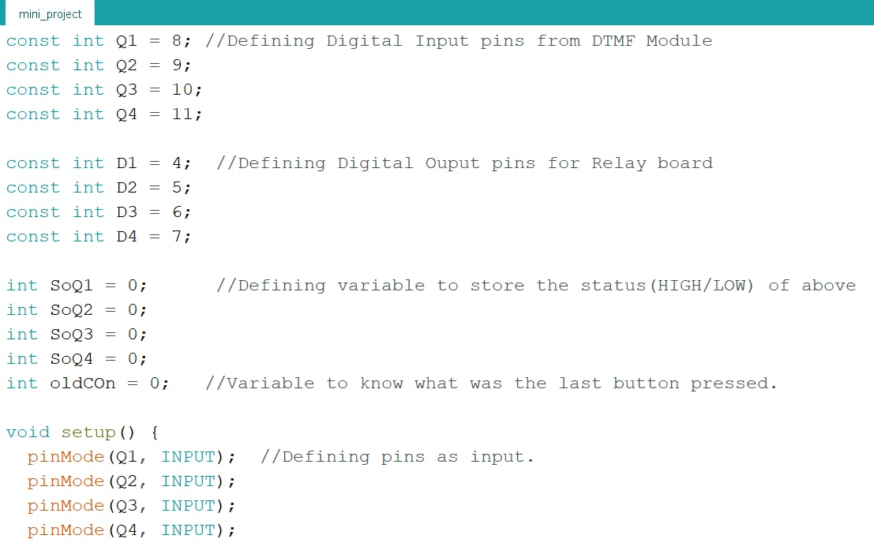
ARDUINO CODE

Slide 20
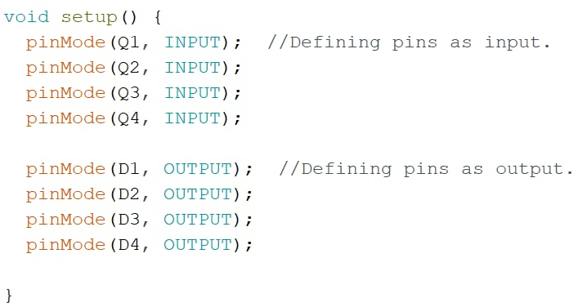
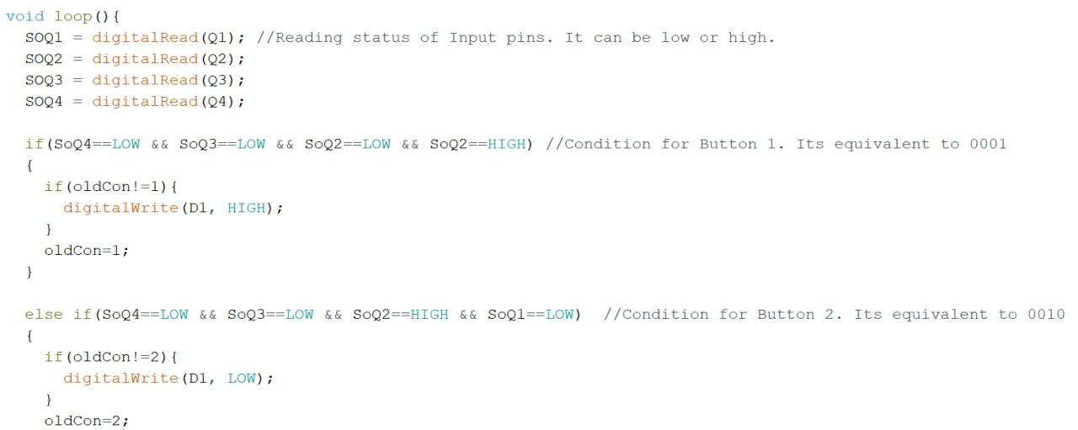

Slide 21
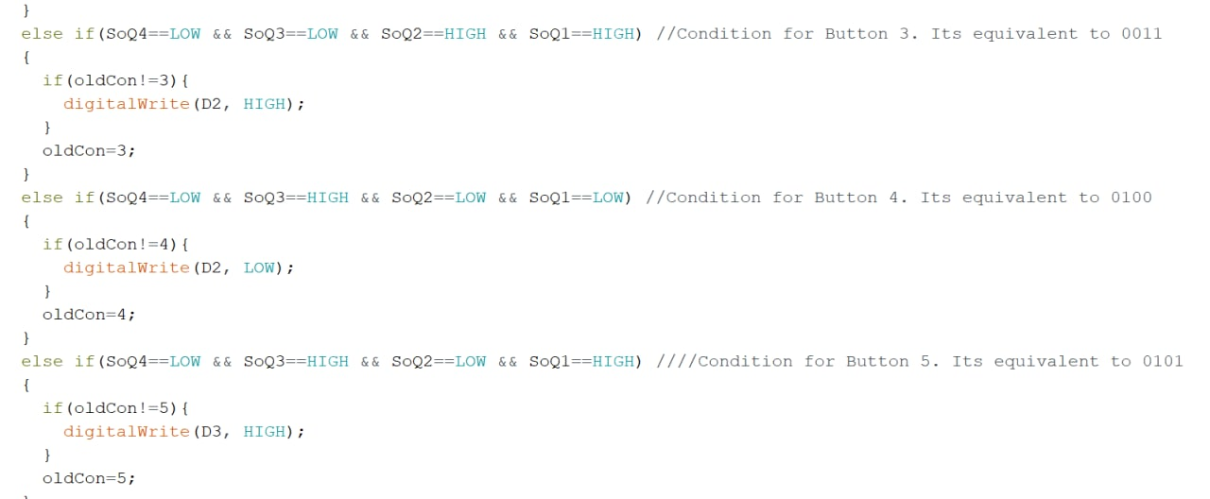

Slide 22
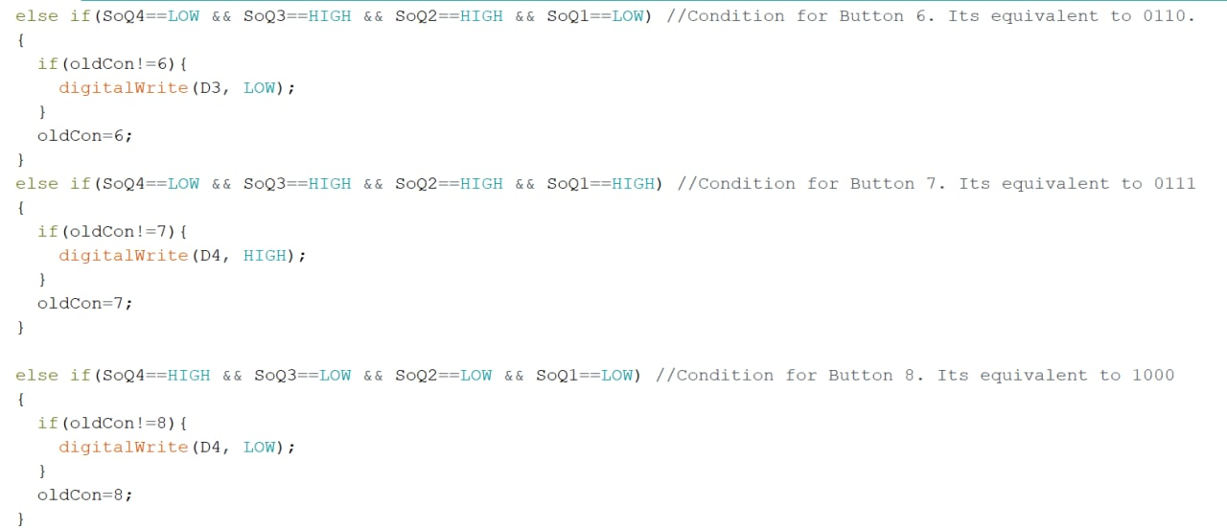
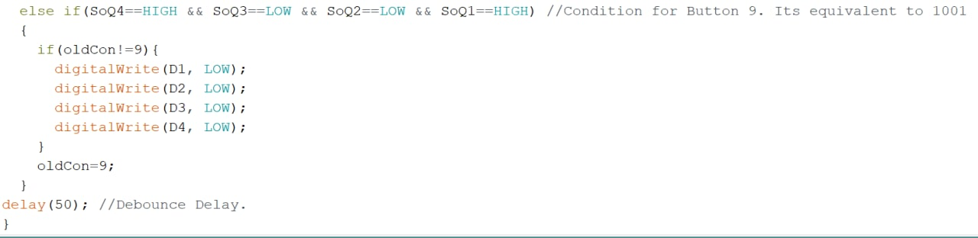

Slide 23
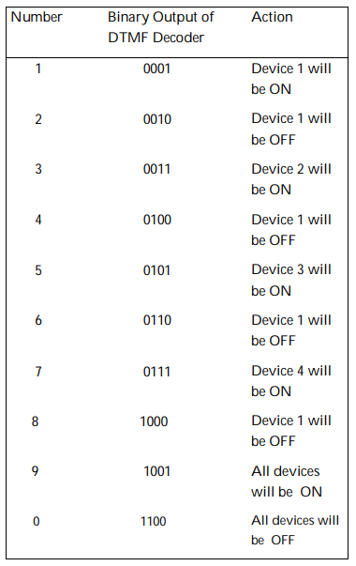
PROJECT OUTCOME
Advantages
It is a robust and easy to use system.
There is no need for extra training of that person who is using it.
All the control would be in your hands by using this home automation system.
One can control home appliances from anywhere.
It reduces wastage of electricity if someone forgets to switch off any appliance connected to the system if we were away.
Disadvantages
Lack of security. Anyone can control the appliances by connecting to the mobile connected to DTMF module.
Number of appliances is limited as our mobile can generate only 16 tones.
One mobile phone should always be connected to the system

Slide 24
Future Work
Memory can be used to store the appliance status during power failure.
Sequence detector can be used for more security and control more appliances.
Appliance scheduler/timer can be implemented using RTC (Real Time Clock) .
Can be converted to an IoT device using Wi-Fi connectivity.
Conclusion:
DTMF Based Home Automation has been designed and setup.
It has been possible to control all home appliances automatically using our own mobile phones.
The control of all appliances is possible even from a wide range.

Slide 25
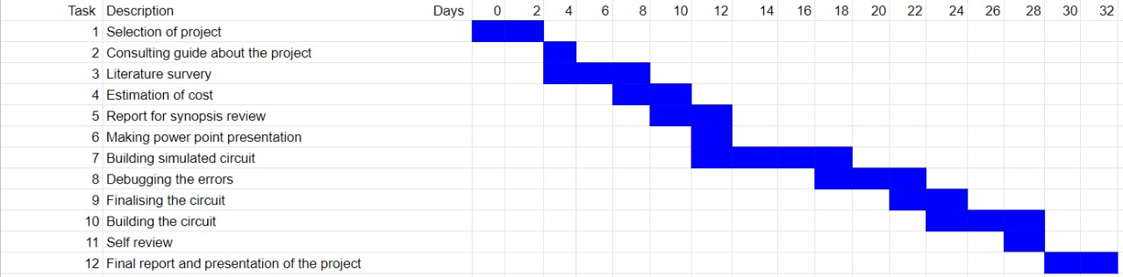
PROJECT PLANNING

Slide 26
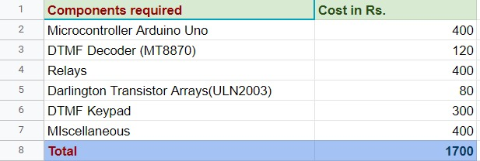
ESTIMATED BUDGET

Slide 27
Reference(Literature survey) details
https://www.uchobby.com/index.php/2007/09/30/phone-to-microcontroller-interfacin g-with-dtmf/
https://www.ijltet.org/pdfviewer.php?id=921&j_id=3980
https://pdfs.semanticscholar.org/9420/0718d283d19df88b90eca6fff33bd86094b2.pdf
M. Van Der Werff, X. Gui, and W.L. Xu, “A mobile based home automation system,” 2nd International Conference on MobileTechnology, Applications and Systems, Guangzhou, 15-17 Nov. 2005.
https://en.wikipedia.org/wiki/Home_automation

Slide 28
THANK YOU

